Slide 1
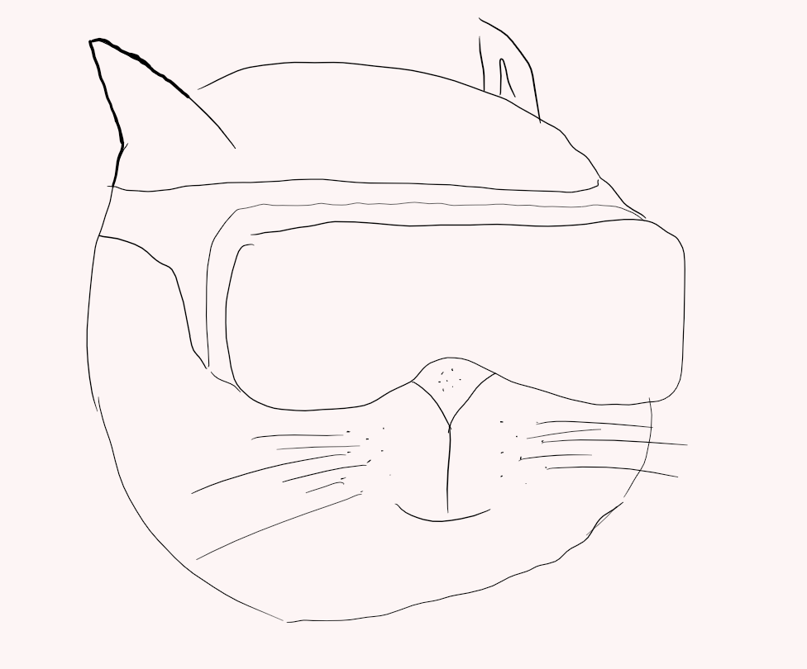
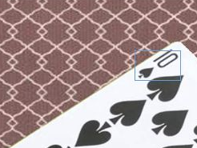

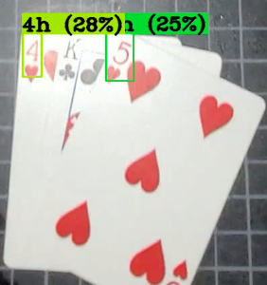
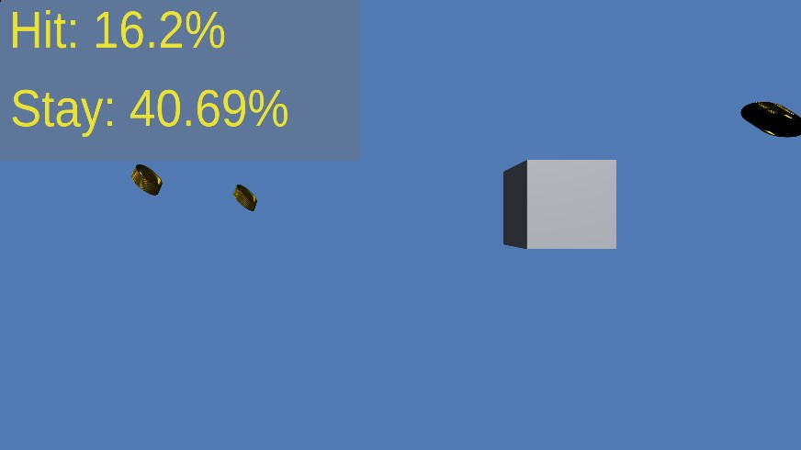
AR/VR Blackjack Assistant Game Sponsor: Bill Michael Advisor(s): Dr. Dana Wortman Jack Brock, Amber Dolezal, Austin Hobbs, Amyleila Mejia, Stefano Signorelli
Company or Team Logo
Background
Our task was to implement a program with an AR headset that ran on a separate computer, and streamed processed data back to the headset, as opposed to the entire program running on the headset. The purpose of this is mainly to increase the battery life of the headset, but other auxiliary advantages exist, such as running programs the headset doesn't have the computational power to handle.
Our chosen program is a blackjack helper, which provides the user with game statistics to help a novice+ win at blackjack.
While we have gotten most of our project working, object detection continues to give us difficulties, prohibiting us from providing a full demonstration of our product. Without this final key component, we are unable to fully fulfill the original requirements, and thus cannot meaningfully test for many of them, such as the improved battery life of the device.
Results
We successfully connected the HoloLens to our provided router and successfully setup communication (outside of a game).
The UI renders correctly, and successfully updates on the screen probabilities with a given set of dealer & player cards.
YOLO was able to successfully identify playing cards, however was unable to fully integrate to final project.
An overlay (coins) was made to show when player hits 21 or wins.
Sound plays when player loses.
YOLO successfully identifies cards in the webcam scene using darknet.
Team Name: ARAnnihilators

